Slide 1
Toronto Vs Manhattan

Slide 2
Helping investors choose a business
When trying to invest in new place it is always recommended to see how will a business doing
Using Data Analysis we can help investors see how well are businesses doing in their city of choice

Slide 3
Data Aquesition
The data for Toronto have been acquired from: 'https://en.wikipedia.org/wiki/List_of_postal_codes_of_Canada:_M’
The Data for Manhattan was acquired from per processed csv file obtained from the ‘Neighborhoods-New-York-py-v1.0’ Lab.
Venues for both cities are acquired from Foursquare API platrform

Slide 4
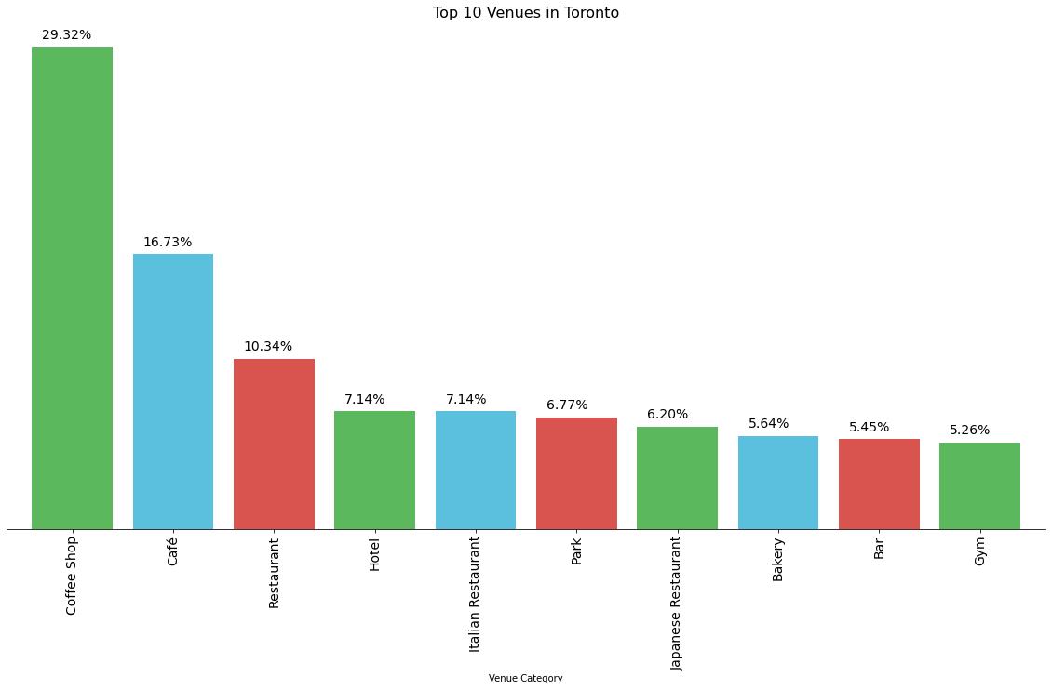
Top 10 venues in Tornto

Slide 5
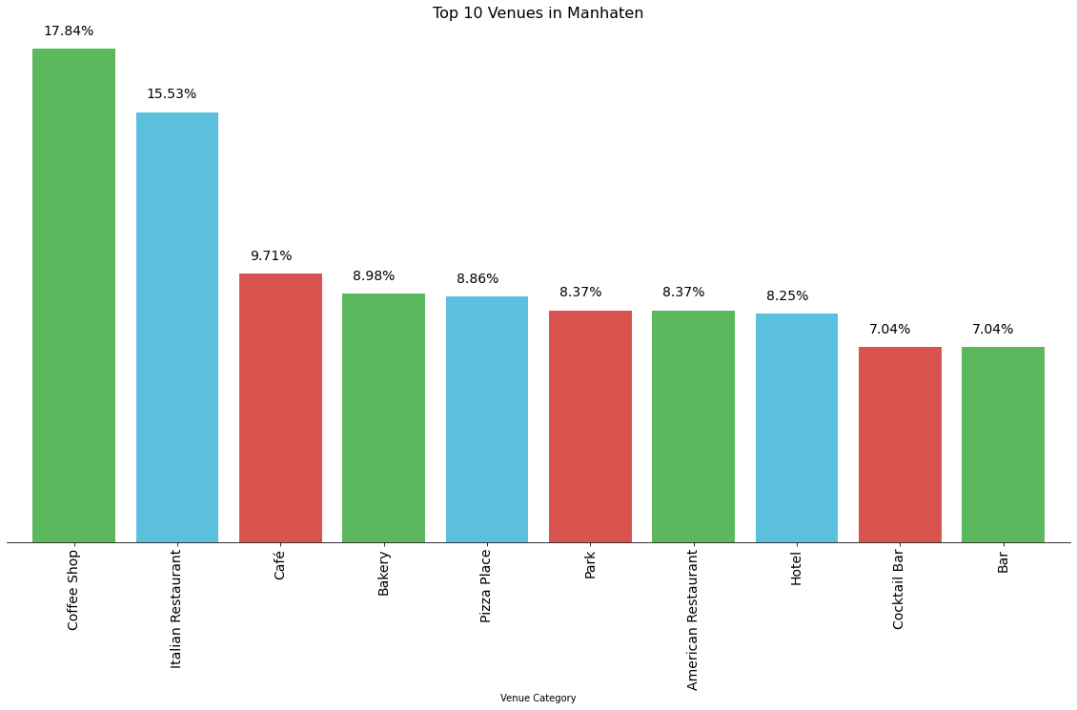
Top 10 Venues in Manhattan

Slide 6
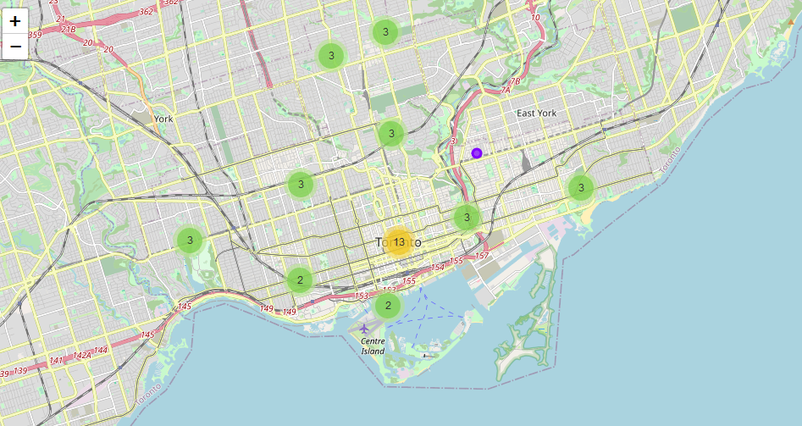
Torono Cluster map

Slide 7
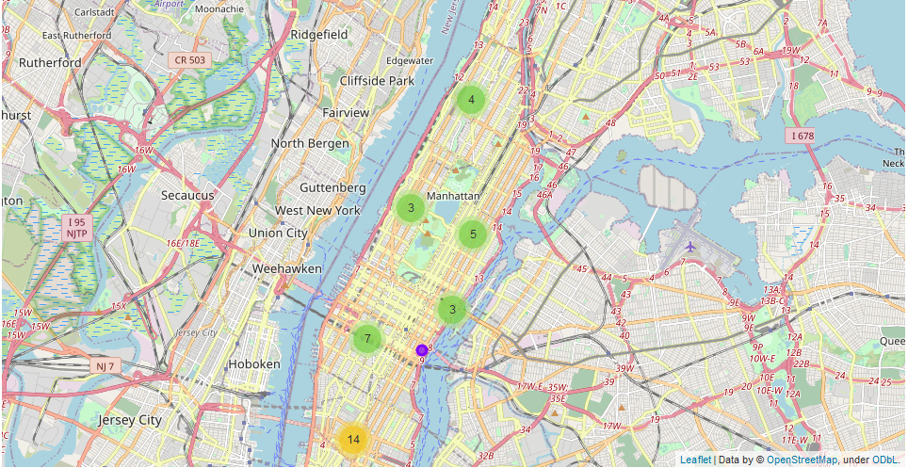
Manhattan Cluster Map

